Slide 1


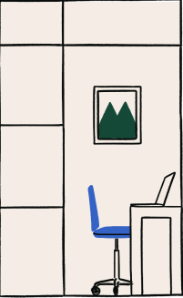


MYP 4
UNIT 3
Cultural Assumptions

Slide 2
Learning Goals
WE WILL UNDERSTAND
I WILL BE ABLE TO
What cultural assumptions are and why they matter.
How they shape texts and audience responses.
Where cultural assumptions come from.
Identify cultural assumptions in texts.
Analyse how texts position audiences.
Reflect on my own cultural assumptions.

Slide 3
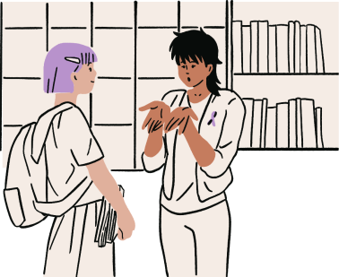
CLASS DISCUSSION
5 MINUTES
What Makes Up “Culture”?

Slide 4





Social Class
Religion
Ethnicity
Culture
Youth
Gender
Sexuality
Disability
Work
Age

Slide 5
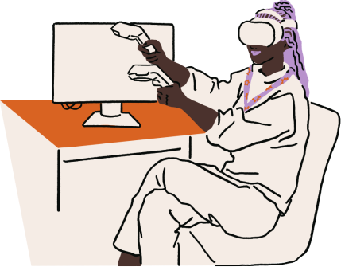
LET’S DEFINE IT!
What are Cultural Assumptions?

Slide 6
Cultural Assumptions
Cultural assumptions are ideas, beliefs or attitudes about such things as gender, religion, ethnicity, youth, age, disability, sexuality, social class and work that are taken for granted as being part of the fabric of the social practices of a particular culture. Cultural assumptions underpin texts and can be used to position audiences.

Slide 7
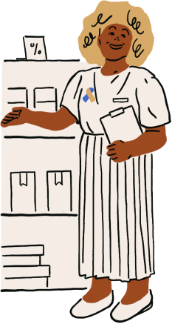
Why Are They Important?
Cultural assumptions are a critical element in most senior English analytical and creative tasks. They shape how we create, interpret and analyse texts. They are embedded in plot, language, characterisation, values, and overall structure of texts.

Slide 8
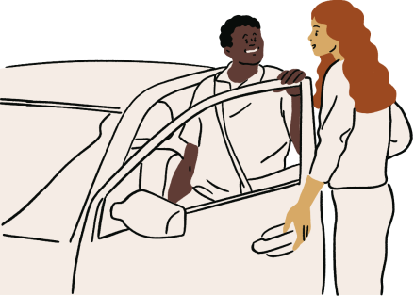
BRAINSTORM
Where Do Cultural Assumptions Come From?

Slide 9
Where They Come From
Cultural assumptions come from a range of places, including:
Family upbringing and early socialisation
Formal
education and
the curriculum
News media, film, TV, music, and advertising
Language
norms and
idioms
Religious or community teachings
Historical narratives (e.g. colonialism, war)

Slide 10
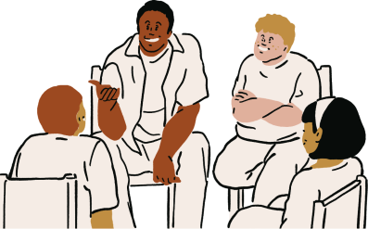
DISCUSSION
How Do Cultural Assumptions, Stereotypes, and Generalisations Differ?

Slide 11

How Do They Differ?
CULTURAL ASSUMPTION
STEREOTYPE
GENERALISATION
An implicit societal belief or value accepted within a cultural group.
An oversimplified, fixed idea applied to all members of a group.
A broad statement about a group that may contain truth, but lacks nuance.
Assumptions shape stereotypes and generalisations.
They aren’t always harmful, but should be examined.

Slide 12

Let’s Look At Examples!
CULTURAL ASSUMPTION
Teenagers are digital natives.
All teenagers are addicted to phones.
STEREOTYPE
Many teenagers enjoy social media.
GENERALISATION

Slide 13
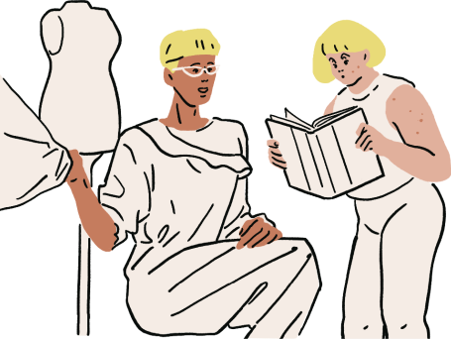
BRAINSTORM
How Can We Identify Cultural Assumptions (CA) in Texts?

Slide 14
Identifying CA in Texts
Some questions to identify cultural assumptions in texts:
What values are portrayed as normal or ideal?
What social roles are reinforced or challenged?
Who gets to tell the story? Whose voice is missing?
Example: An advertisement that only shows women doing housework may reinforce assumptions about gender roles.

Slide 15
Common Assumptions
GENDER
CLASS
AGE
Women are caregivers; men are providers.
Wealth equals virtue or intelligence.
Youth are irresponsible or naïve.
RACE
DISABILITY
WORK
White perspectives are universal or default.
Disabled people are inspirational or helpless.
A person's worth is tied to their job or career success.

Slide 16
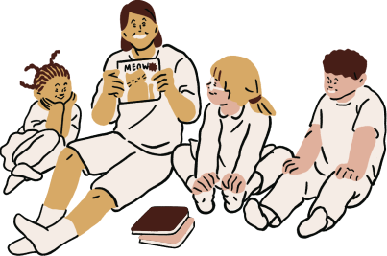
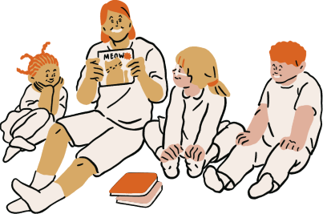
CLASS DISCUSSION
How Do Cultural Assumptions Position Audiences?

Slide 17
Positioning Audiences
Texts encourage the audience to adopt particular attitudes:
SYMPATHY
JUDGEMENT
ACCEPTANCE
Toward a character or cause.
Of a behaviour or social group.
Of certain values or ideologies.
Positioning is not always obvious. Consider tone, narrative voice, camera angles (in film), or figurative language.

Slide 18
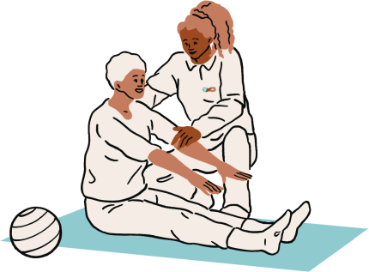
CLASS DISCUSSION
How Can We Subvert Cultural Assumptions in Our Writing?

Slide 19
Subverting Assumptions
Some ways we can subvert cultural assumptions include:
Reframing marginalised characters.
Critiquing dominant ideologies.
Using satire
or irony to
reveal biases.
Example: A comedy that shows a stay-at-home dad managing family life challenges assumptions about gender roles.

Slide 20
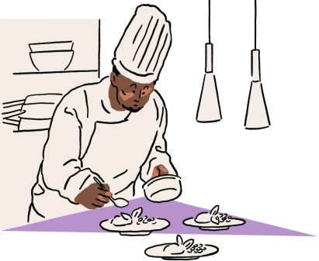
WRAPPING UP
Reflection Activity

Slide 21
Reflective Journal
Choose 2-3 of the following reflection questions to respond to. Lets share...
OPTION ONE
OPTION TWO
OPTION THREE
What is a cultural assumption you’ve grown up with?
Can cultural assumptions ever be positive?
How is your writing influenced by assumptions?

Slide 22





THE END!
Thanks YOU

Slide 23
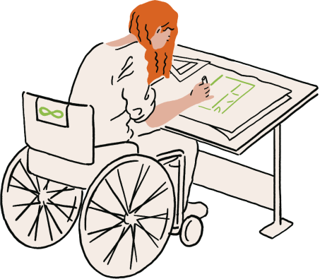




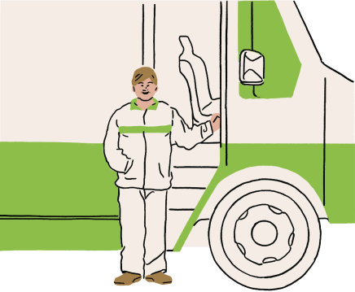


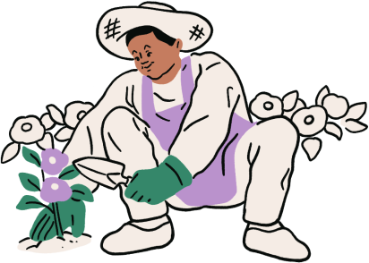
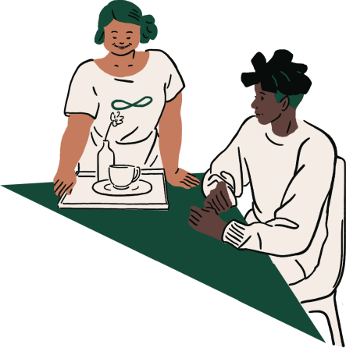
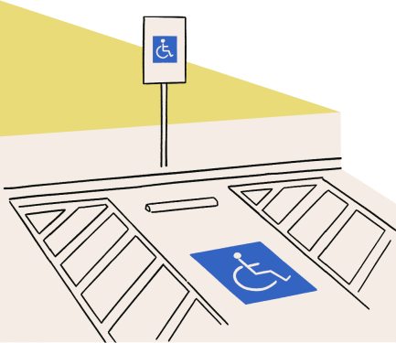

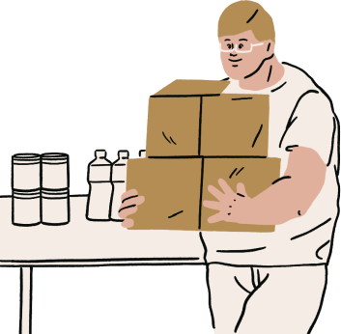
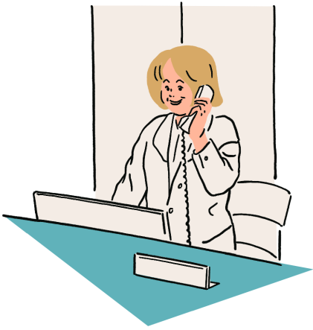
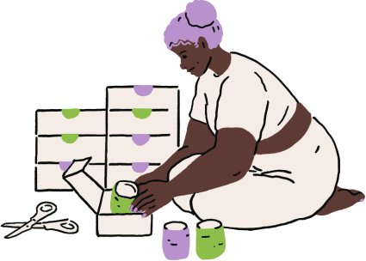
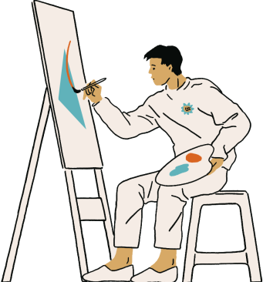
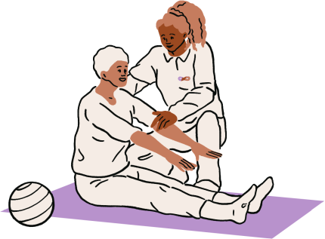


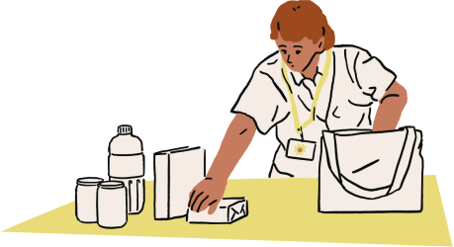
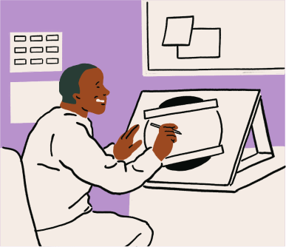

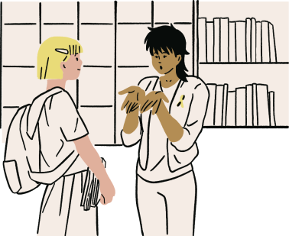

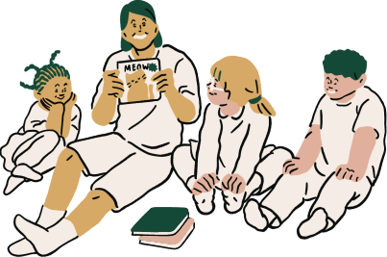
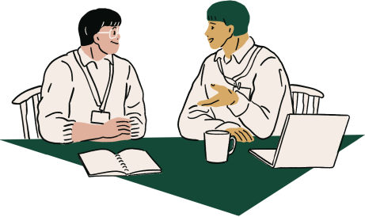


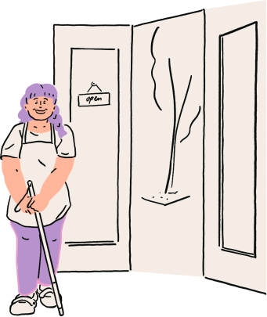
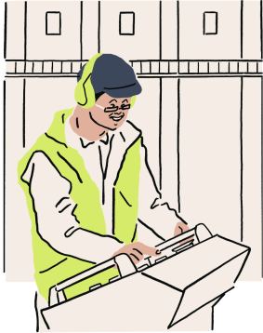
Resource Page

